Slide 1
Classical India
Jainism
Buddhism
Hindu Renaissance
Imperial State

Slide 2
Jainism
Jainism
  Vardhamana Mahavira. (b. 540 B.C.E.)
  Animism
    Karma and the Soul
  Jain practices and Five Great Vows
      Ahimsa
      Satya
      Asteya
      Brahmacharya
      Aparigraha
  Sallekhana, or Santhara

Slide 3
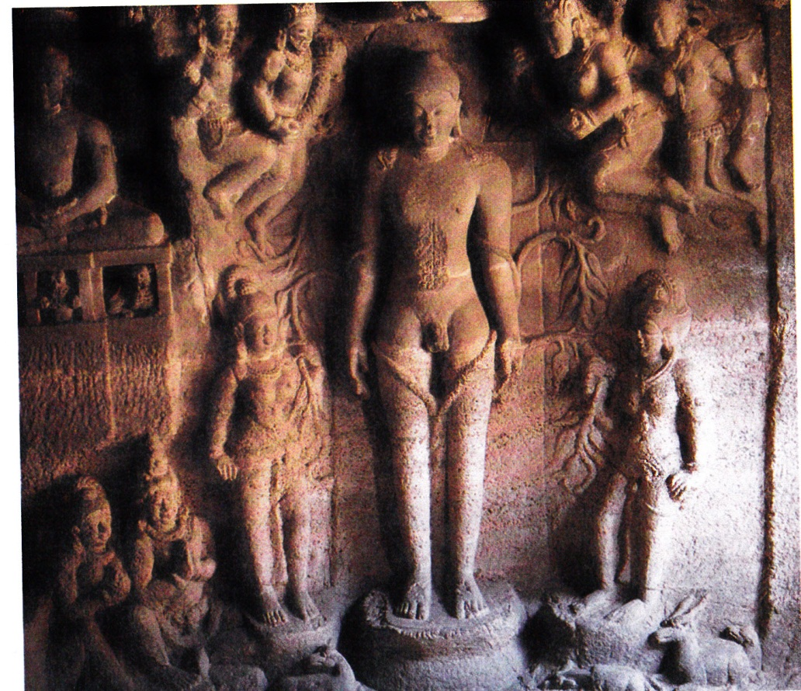
Jain saint

Slide 4
Buddhism (mid 400’s B.C.E.)
  Siddhartha Gautama
  Basic tenants of Buddhism
    Four Noble Truths – Path to stop suffering and reach enlightenment
      Dukkha: Life is full of suffering
      Samudāya: Suffering stems from desire
      Nirodha: Need to cease all desires
      Magga: The Noble Eightfold Path
        Correct views, intent, speech, actions, trade, effort, mindfulness, and concentration.
  Buddhist Divisions (1st c. C.E.)
    Theravada
      Pali Canon (Dhamma) – cosmic law and order
      No supreme being
      Acquire merit through devotion, meditation, and good works.
      Reincarnation and Nirvana.
    Mahayana (Buddhism becomes a religion)
      Buddha becomes a God
      Bodhisattva

Slide 5
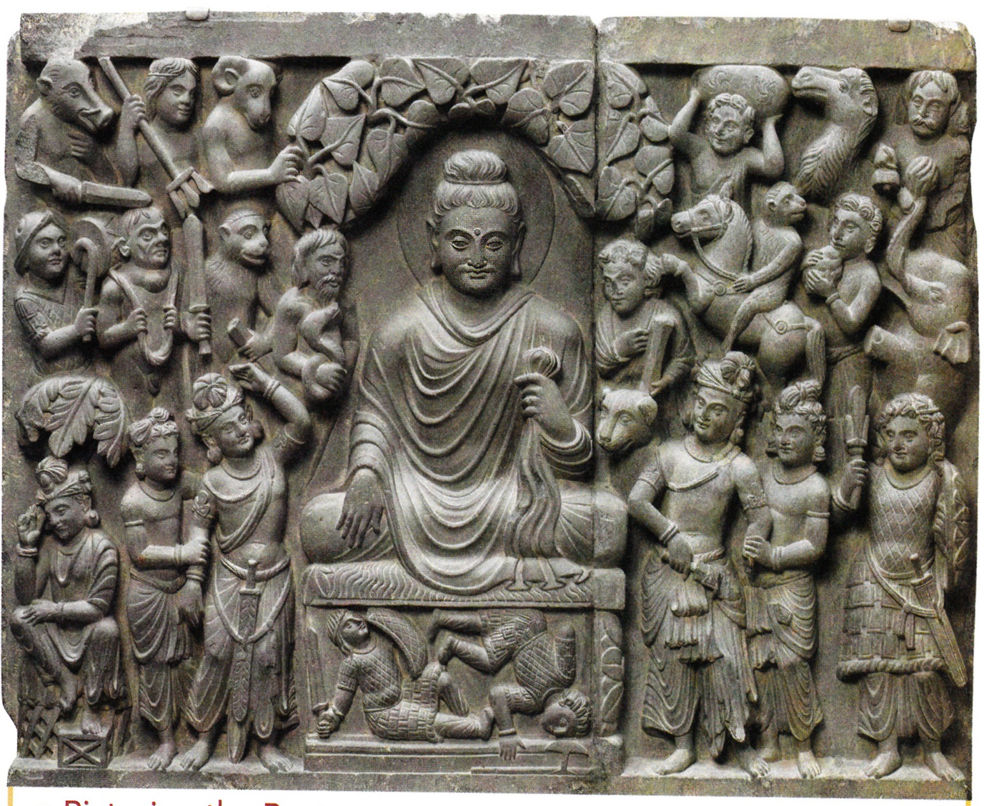
Buddha below the bo tree

Slide 6
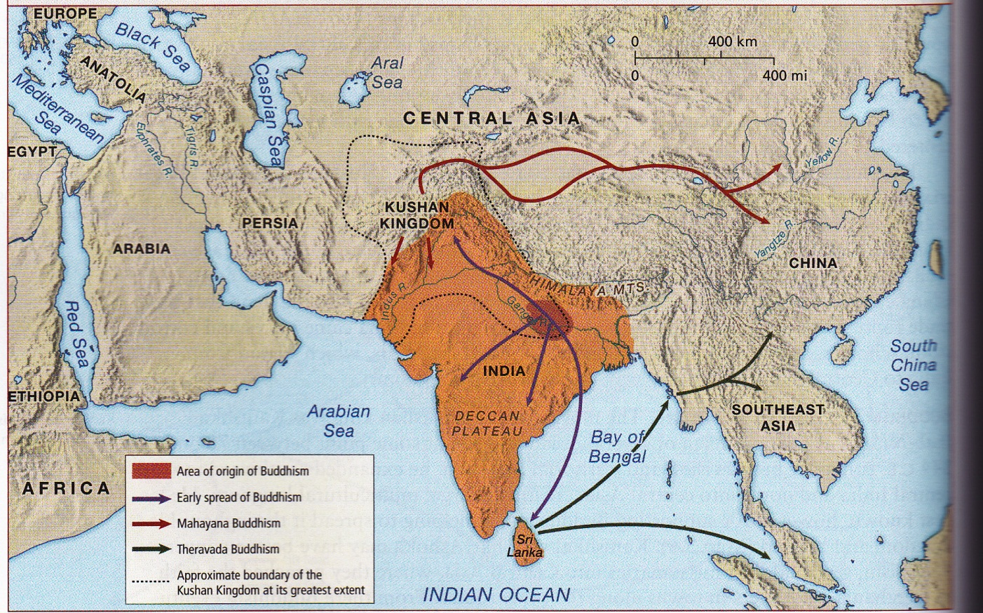

Slide 7
Hindu Renaissance
Jainism and Buddhism challenge Hinduism
Developments in Hinduism (Between400B.C.E. and 200 C.E)
  Brahman- universal reality.
    Innumerable ways of worshiping Brahman including
      Dharma
      Bhakti
        Development of the Hindu Trinity
          Brahma – creator of life
          Vishnu – preserver of life
          Shiva – destroyer of life

Slide 8
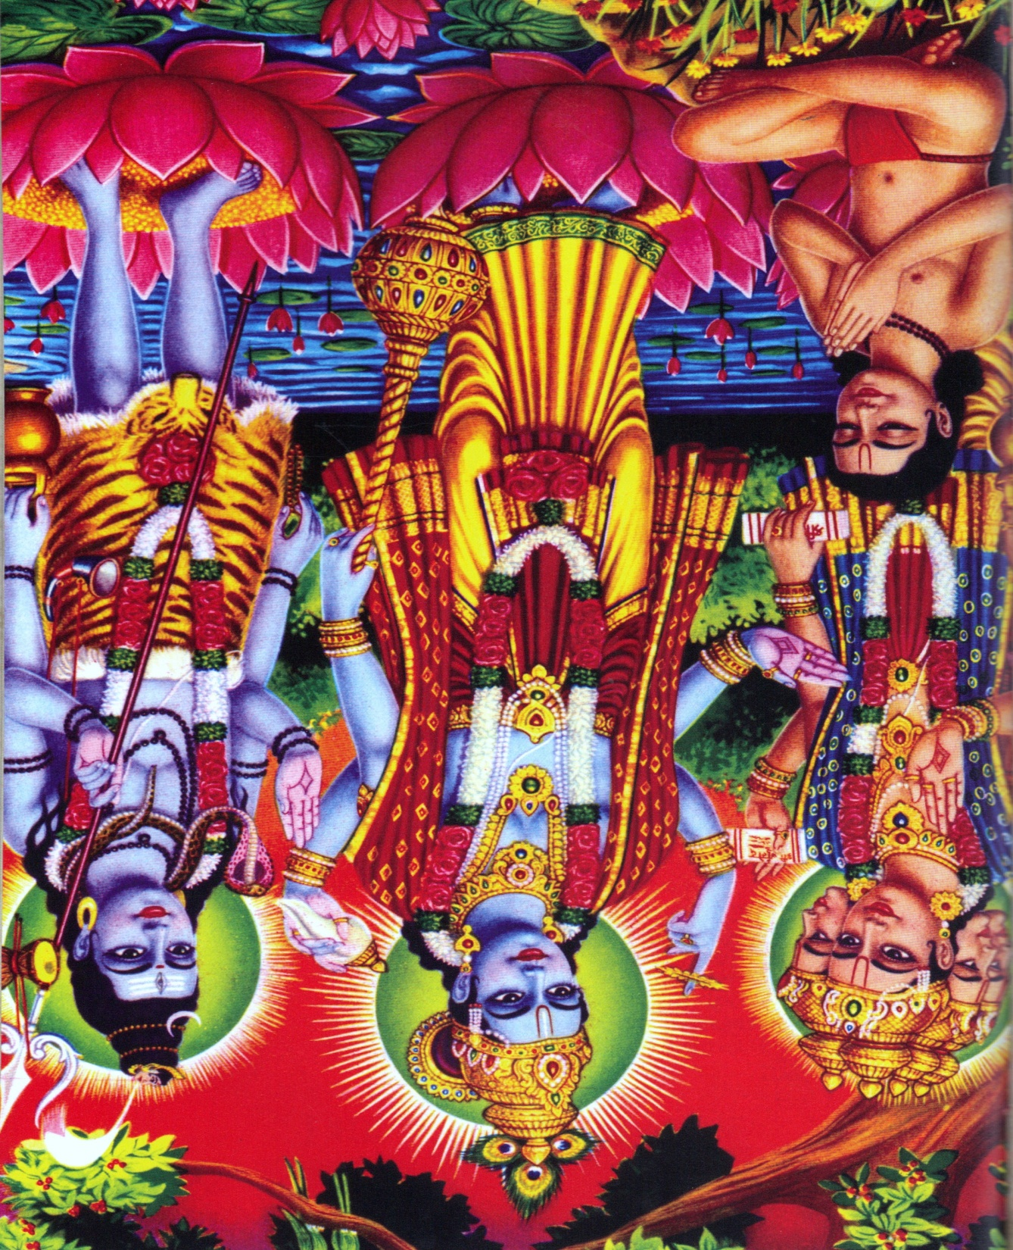

Slide 9
Imperial Mauryan State(322-185 B.C.E.)
Chandragupta Maurya
  Imperial State
    Large standing army
    Heavy taxation to fun government
    Impressive system of roads.
Ashoka (273-231 B.C.E)
  ahimsa
  Welfare state
  Large army

Slide 10
